Slide 1
Git Yourself Together
By Simon Thurston

Slide 2

ECE & CS Dual Major
Former IRT Employee
Former IEEE Webmaster
Contributed to various Open Source Projects
Knows things

Slide 3
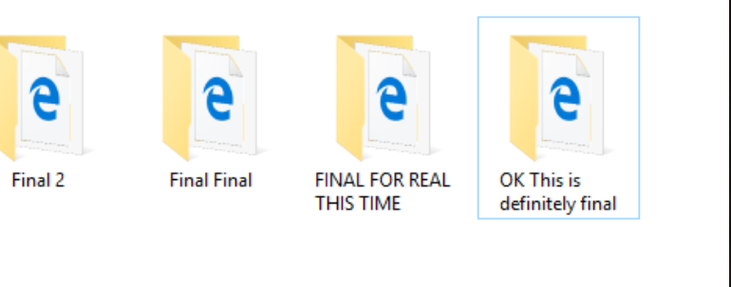
Has This Ever Happened To You?

Slide 4

What’s the Solution?

Slide 5



Install some programs or something
https://git-scm.com/
The software that allows you to actually perform the tasks, and do version control on your projects and whatnot.
https://github.com/ https://about.gitlab.com/
Online/Remote Repository Hosting, so you can chuck those files onto the cloud and download them later, or somewhere else, or share them.
Like Google Drive for your Git projects, but better.

Slide 6
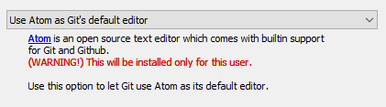
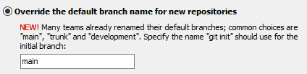
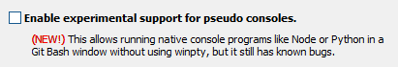
Some Recommended Settings
Pretty much all of these are defaults, and I recommend you keep them that way, with the exception of these 3:
I personally recommend Atom as a Text Editor, but you can also use VSCode, Notepad++, Vim, or any other you’d like to try or are used to.
Most Git projects are moving to use ‘main’ by default now, but changing it back to ‘master’ or something else entirely might be preferable.
The Git Bash Terminal is pretty great, and enabling this lets you run regular console commands inside of it, but I’ve tried it before and it is not stable, so you can enable this at your own risk!

Slide 7
Last Step!
Set these to be the same as your username on Github/Gitlab, and the email you used to sign up with! This will help when signing in to the service later.

Slide 8
Setting Up Projects

Slide 9
Using GUI
Using Git Bash
Go ahead and make a folder anywhere, and put your files into it. Navigate to it using your file explorer, and right click in the folder, choosing “Git Bash Here”
Use the cd command to change your directory to your project folder, i.e.
cd C:\Users\USERNAME\src\Project
Then use whatever tools you want to copy your files over or make new ones.

Slide 10
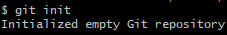
LET THERE BE GIT

Slide 11
Basic Git Usage
There’s really only 2 commands that will get you through most of your Git problems.
git add -A
This adds all of the files in the folder to the git repository, staging them in their current states. Without the -A, you can specify individual files in the folder to add.
git commit -a -m “This is my commit message because I am swag and cool and will inform my teammates of what I'm working on”
This commits all of your staged files/changes to the project’s repository, in the states they’re in when you added them, to be recalled later or overwritten by newer changes. This means if you git add a file, then change the contents, then commit after changing, your changes won’t be saved. You’ll have to git add again before git commit-ing.

Slide 12
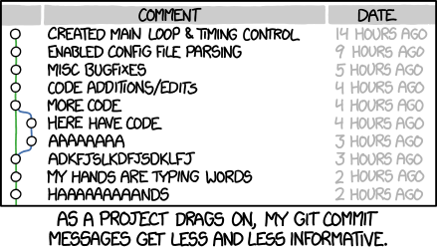
Commit Messages: Do’s and Not Do’s

Slide 13
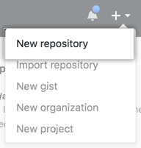
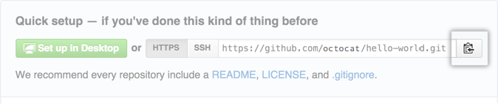
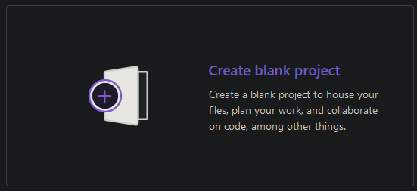
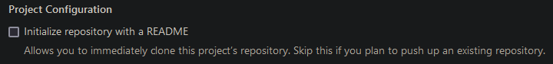
Git… On The World Wide Web
git remote add origin [The URL you copied here]

Slide 14
Push it.
git push --set-upstream origin main

Slide 15
The Remote Workflow

Slide 16
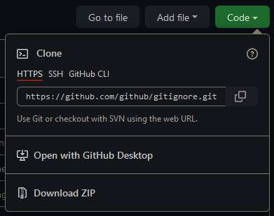
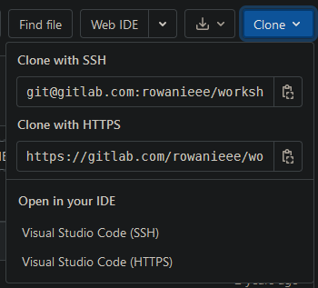
Attack of the Clones
git clone is for when there’s some remote repository already made that you need to get onto your local machine before starting to work on this. It essentially functions as a git init/remote add/pull, like shown in the previous slides, but while those initial commands could potentially mess with how your own local copy looks compared to the remote, clone copies the current status of the remote repository perfectly to your computer, making it easy to get up and running with remote projects.
There’s some handy shortcuts for getting clone urls through Github and Gitlab as well!

Slide 17
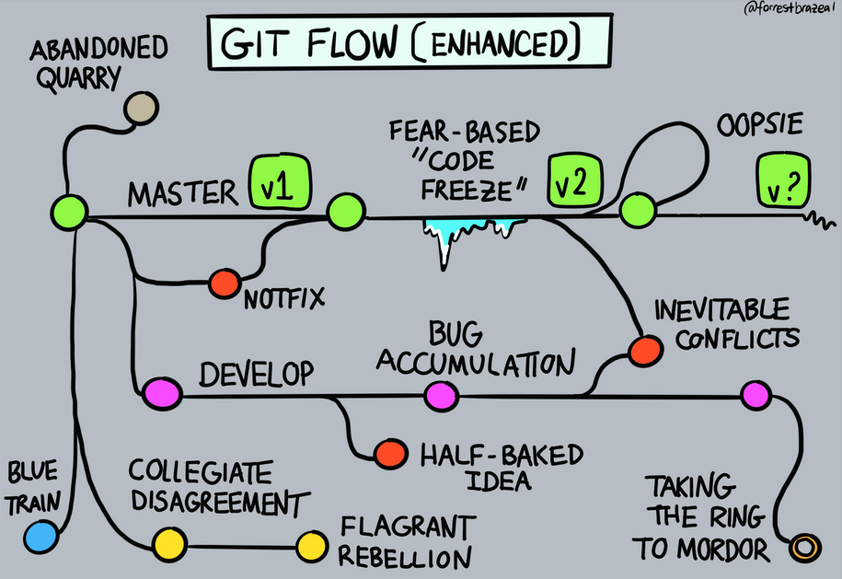
Branch
Branches are an easy way to allow simultaneous collaboration on one project. You can have a branch for yourself, your coworkers, the features, or anything else you want. You can even make your branches have branches, or your branches’ branches have branches. It’s branches all the way down.
But typically: Branch from main for each feature/bugfix, then branch from those branches for each individual person working on the code.

Slide 18
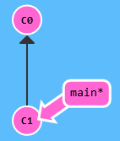
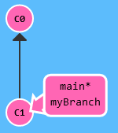
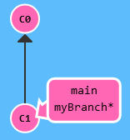
How Branching Looks:
Step 1: git branch myBranch
Step 2: git switch myCoolBranch

Slide 19
Ok, but now do it faster
Step 1: git switch -c myBranch
One command to make a branch and switch to it!

Slide 20
Push Branch to Github/Gitlab
After adding some commits to your branch, you need to push it to the remote repository on Github or Gitlab! Luckily, this command makes it very easy:
Will automatically create branch on the remote repository for you, no hassle needed!
But how do we fully update our project, now that we have all of these branches?

Slide 21

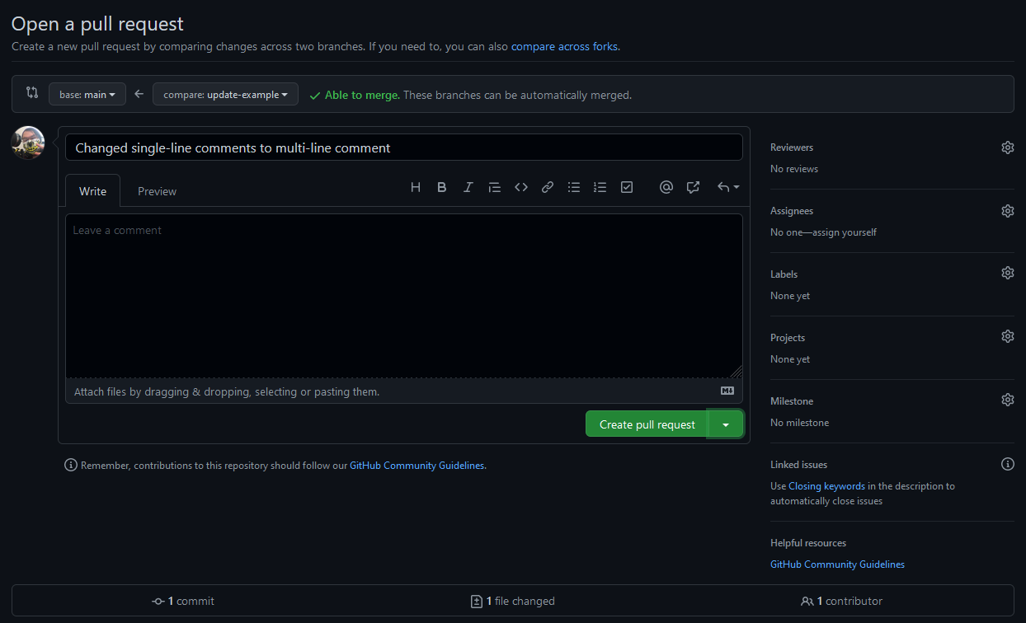
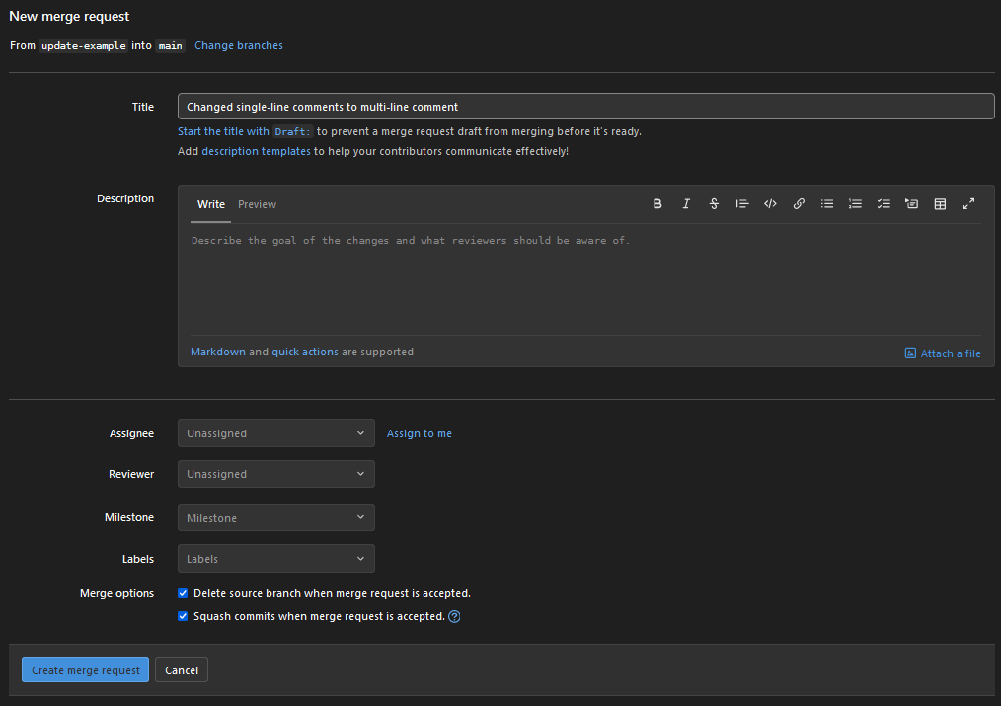
Pull Requests

Slide 22
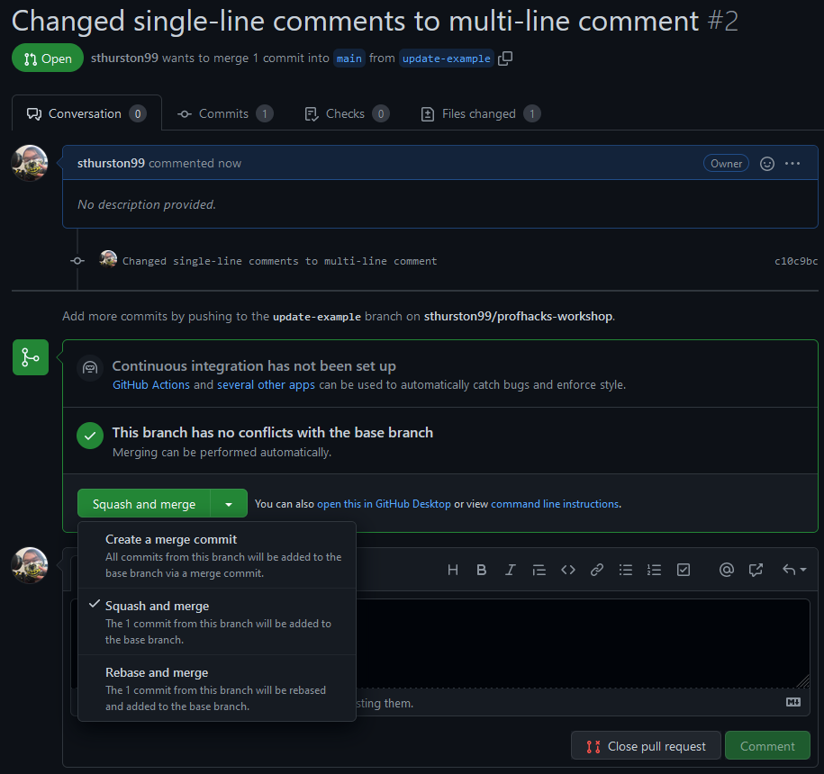
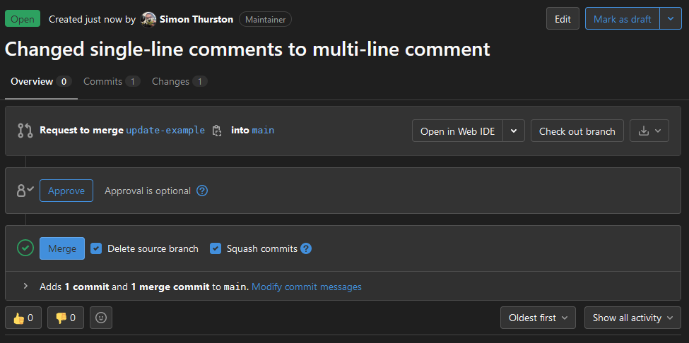

Merging Pull Requests

Slide 23
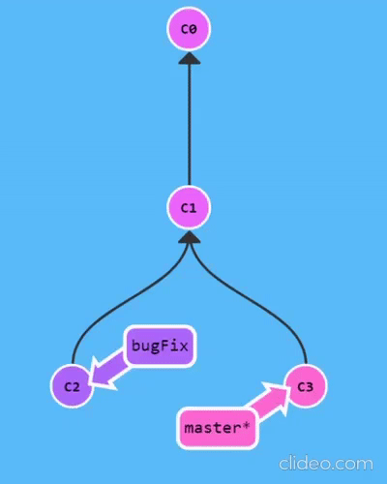
So, what does that actually mean?
So, when a merge request happens, with squashing turned on, a new commit is made on the main branch. This commit will contain one big squashed-down message that has every single commit message from the branch, in the one merge commit.
Normally, the merge commit will point to both the main branch and the feature branch as shown, but squashing causes it to only point to the main branch. This makes it easier to view the tree graph

Slide 24
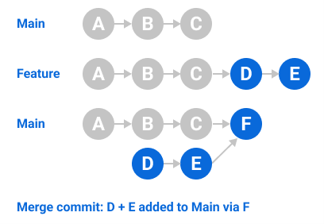
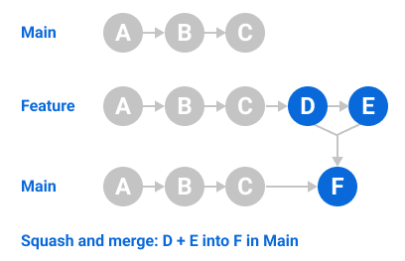
Why Squash?

Slide 25
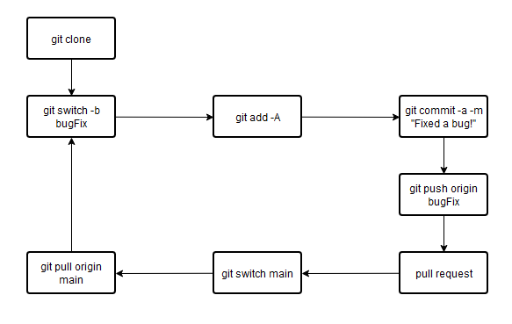
The Remote Workflow: A Summary

Slide 26
Forks
And how they work, kind of.

Slide 27

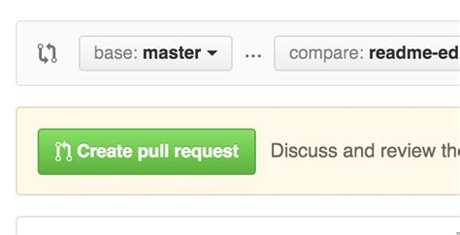
Your own Forking Code!

Slide 28
Practice
https://github.com/sthurston99/profhacks-workshop
https://gitlab.com/sthurston99/profhacks-workshop

Slide 29
Git Wizardry

Slide 30
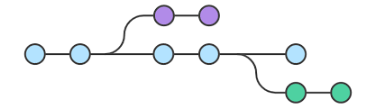
So what exactly is a Branch?
All git databases/repositories are stored in a datastructure called a Tree. Tree’s are pretty easy: You have a “root”, connected to some amount of “nodes”. The different “branches” of the tree represent the relationships between “nodes” or “leaves”.
Because of this, you can branch off of any commit to start working, and all of the history is properly preserved.

Slide 31
Merging Branches
It’s important to note: When merging branches, the branch you have CURRENTLY SELECTED will be the branch preserved in the merge. So it’s smart to switch to the branch you are merging into (i.e. main/master, or a primary dev branch) before merging.
So, if you have made 5 branches, you need to pay attention to the order you are merging them in, as the merge commits wil need to point to the correct references.

Slide 32
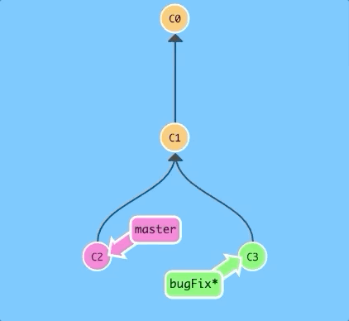
Rebasing Branches
Rebasing moves all of the commits from a branch to point to a new parent node. In this way, you can create a linear history which is a bit easier to follow.
The problem with this is that by doing so, you effectively rewrite the history of the project. So typically, you should only rebase if you 1. Know what you’re doing, and 2. Are working on a private project/repository OR have made a decision with your team to prefer linear history than preserved history.

Slide 33
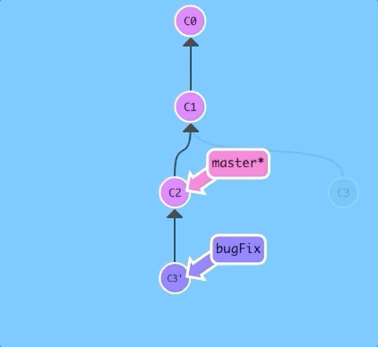
Fast Forward: When Merging and Rebasing is the same.
The one type of state where you don’t need to worry about merging vs rebasing is when you are branched off of the current state of main, and can “fast forward” the main branch to the latest commit. That’s because the only differences between the branches are the ones the newer branch made.
Otherwise, if main has states ahead of where your branch is, you need to either merge to create a merge commit, or rebase to create linear history.

Slide 34

Decapitating your Git Project
So, you’ve seen switching between branches, which is useful for navigating around your different project states. But, you can also switch between individual commits. You can directly do this by using commit IDs, however this is impractical because of how Git stores ref IDs.

Slide 35
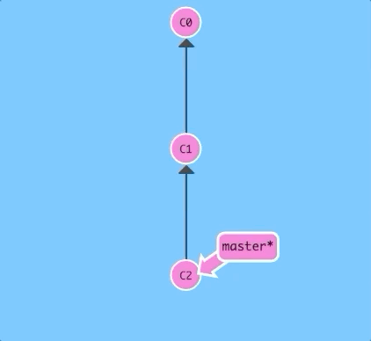
Schmoovin’
Luckily for everyone, Linus Torvalds, who made Git originally as part of the Linux kernel, realized that nobody wants to actually remember unique IDs. So Git has relative references!
In the gif here, you can see the following command:
git switch master^
The Carat ref will return the parent of the given commit or brainch pointer.

Slide 36
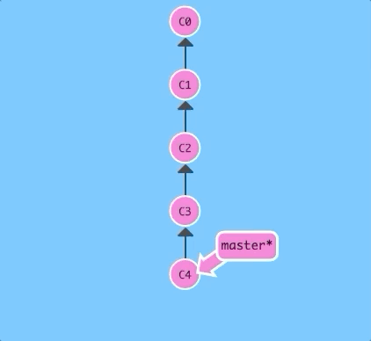
Schmoovin’ 2, Electric Overused Joke
There’s another relative reference operator for when you don’t want to use the same command 17 times, and that’s tilde (~).
git switch master~4
This will switch to the nth parent of the reference given, in this case, the 4th previous commit, our root.

Slide 37
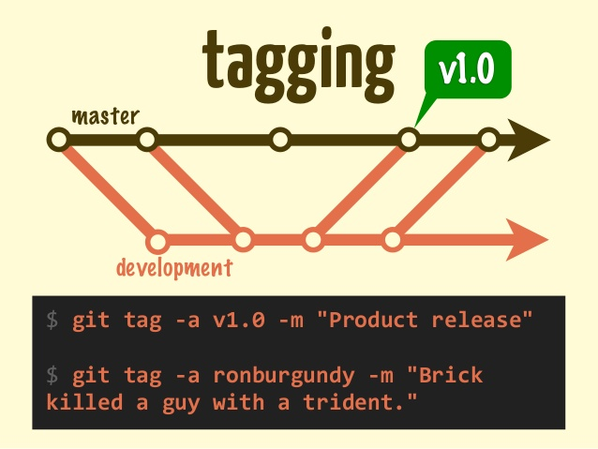
#myEpicGitCommit
Tags are a relatively recent addition to git, for annotating commits, which you can use to switch to. This makes quick access of specific commits much faster and easier.

Slide 38
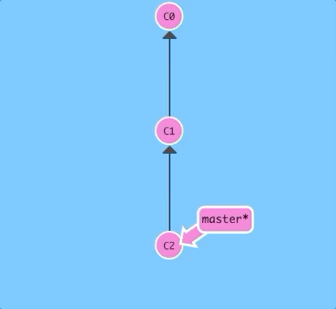
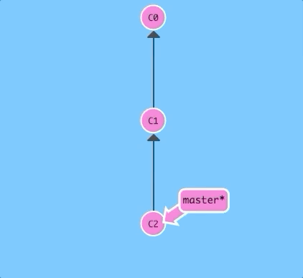
Reset and Revert
When you do an oopsie, and need to undo, you can either Reset or Revert.
Resetting is essentially the same as git rebase master^, since it’ll reset to the previous commit.
Reverting is like fast-forward merging to a previous commit, which helps preserve history in a very good “git flow” like way.
git reset
git revert

Slide 39
Fetch
Fetch is a bit of a unique command as it is used to update the local reference copy of the remote reference tree. This can be used to figure out what changes are going on in the remote repository without affecting the current state of the local repo.
Whenever you use “git pull”, what happens is essentially a chained command of “git fetch; git merge origin/main main”, which essentially means it updates the local copy of the remote repository, then merges it with your local repository.
Pull as a command was made to essentially be a shorthand, but knowing about fetch is still useful as it can help you figure out how far behind your main branch is before merging and potentially causing conflicts, keeping you up to date on the changes going on in a large project.

